Slide 1

New User
Login

Slide 2
LOGO
Find Space
List Space
About Us
My Account
Log Out
Search Location
Workspace Type
Start Date/Time
End Date/Time
Search

Slide 3
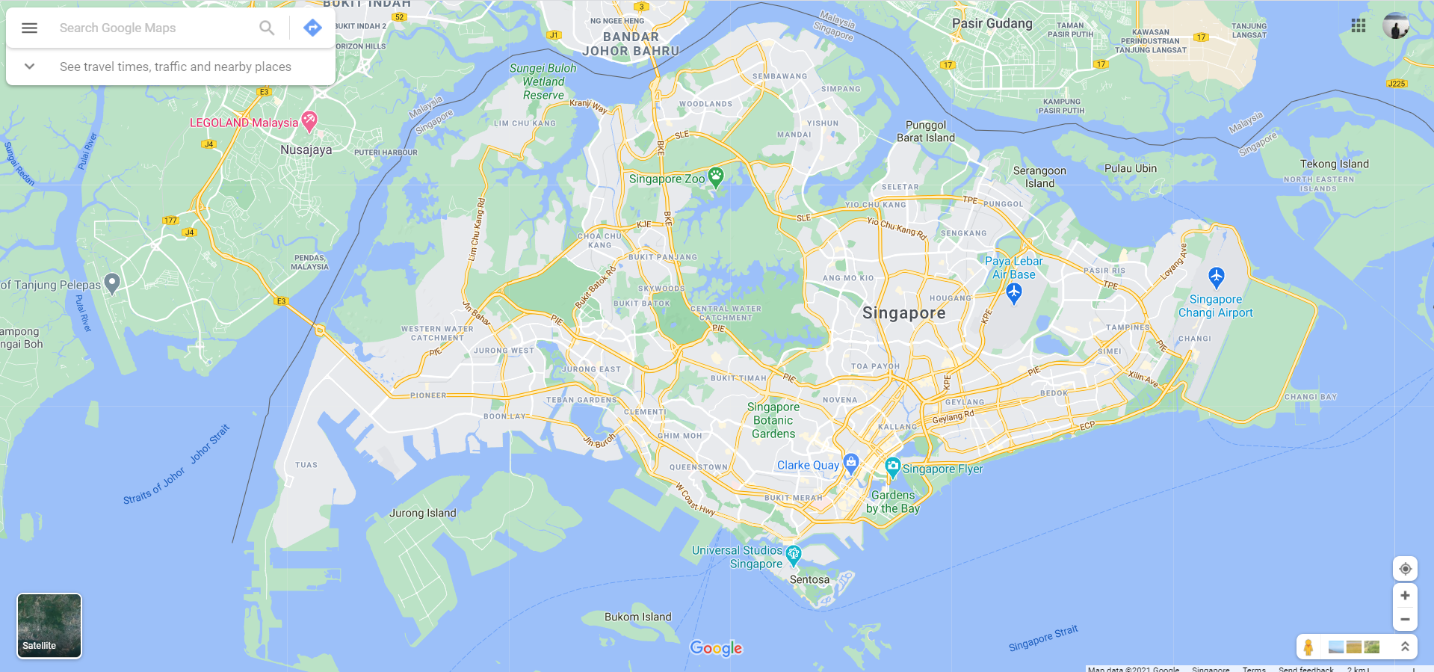
LOGO
Find Space
List Space
About Us
My Account
Log Out
Location A Details
Location B Details
Location C Details

Slide 4
LOGO
Find Space
List Space
About Us
My Account
Log Out
123 Stamford Road, Singapore Management University
Location A Pictures
Monday, 01 March 2021 to Sunday, 07 March 2021
$2345.66
Add to Cart
Alternate Location 1 Details
Alternate Location 2 Details
Alternate Location 3 Details

Slide 5
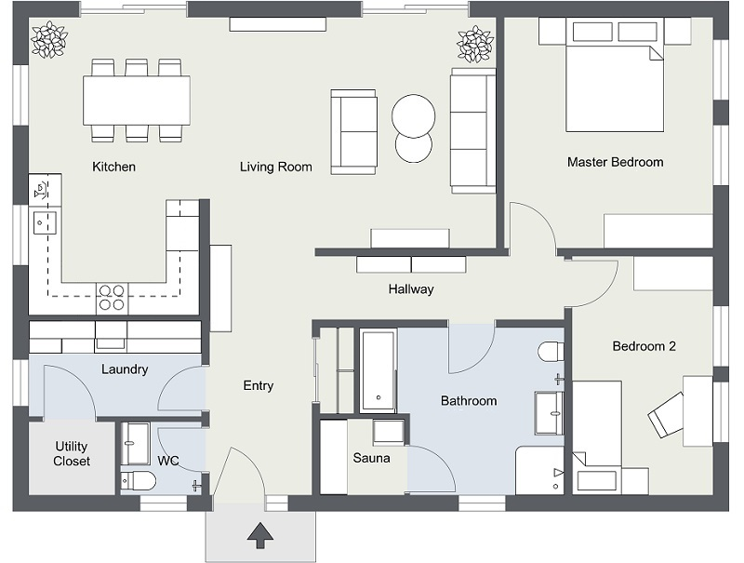
LOGO
Find Space
List Space
About Us
My Account
Log Out
123 Stamford Road, Singapore Management University
Alternate Location 1 Details
Alternate Location 2 Details
Alternate Location 3 Details

Slide 6
LOGO
Find Space
List Space
About Us
My Account
Log Out
Enter Postal Code
Upload Photos
Open for Booking
From:
To:
Daily Price:
Upload
Add Listing

